Slide 2
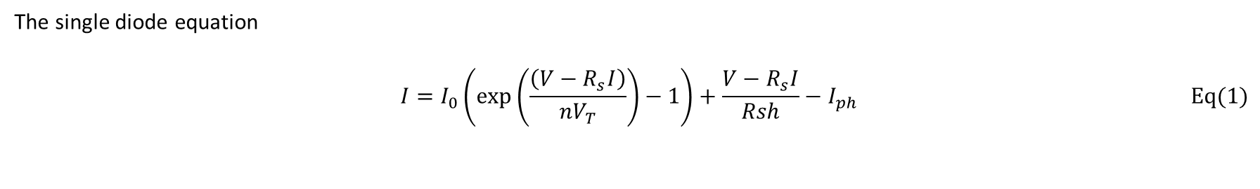
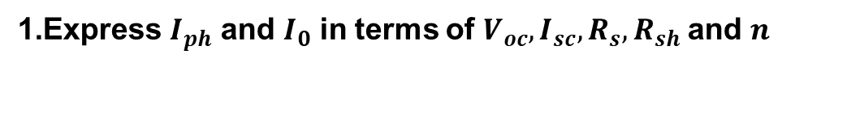
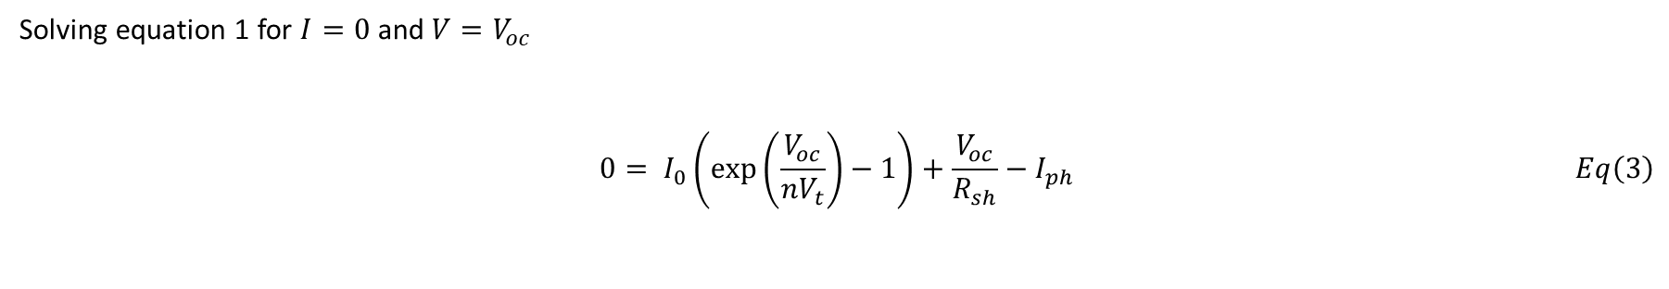
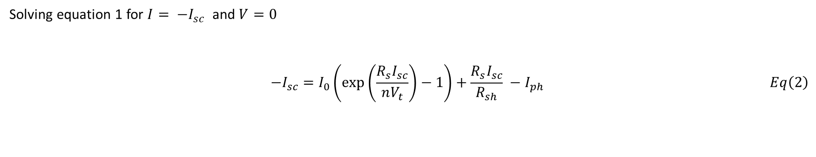
Theory
Express $I_{ph}$ and $I_{0}$ in terms of $V_{oc}, I_{sc}, R_{s},R_{sh}$and $n$
The single diode equation
$$\begin{aligned}\begin{aligned}I=I_{0}\left(\exp\left(\frac{\left(V−R_{s}I\right)}{nV_{T}}\right)−1\right)+\frac{V−R_{s}I}{Rsh}−I_{ph} \#\end{aligned}\#Eq(1)\end{aligned}$$
Solving equation 1 for $I= −I_{sc}$ and $V=0$
$$\begin{aligned}\begin{aligned}−I_{sc}=I_{0}\left(\exp\left(\frac{R_{s}I_{sc}}{nV_{t}}\right)−1\right)+\frac{R_{s}I_{sc}}{R_{sh}} −I_{ph} \#\#\#\#\#\#\#\#\end{aligned}\#Eq\left(2\right)\end{aligned}$$
Solving equation 1 for $I=0$ and $V=V_{oc}$
$$\begin{aligned}\begin{aligned}0= I_{0}\left(\exp\left(\frac{V_{oc}}{nV_{t}}\right)−1\right)+\frac{V_{oc}}{R_{sh}}−I_{ph}\end{aligned}\#Eq\left(3\right)\end{aligned}$$

Slide 3
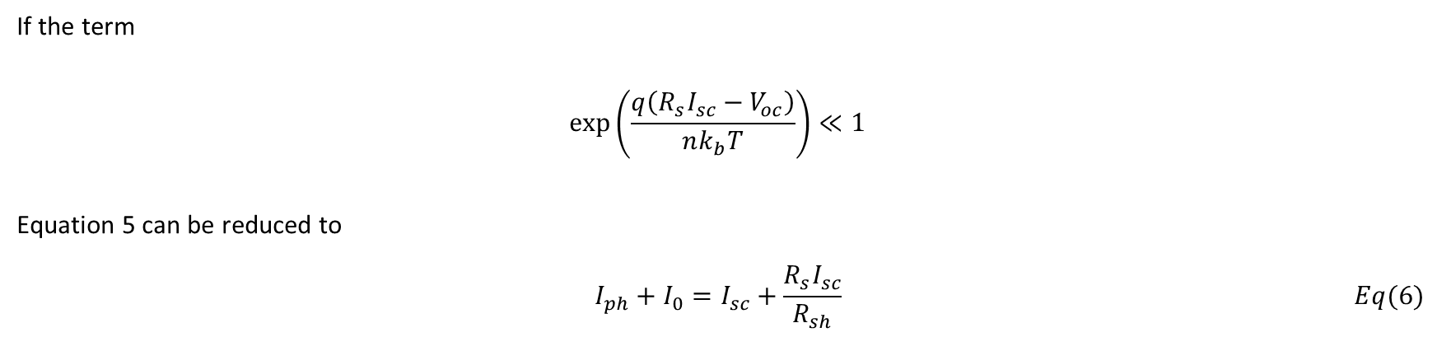
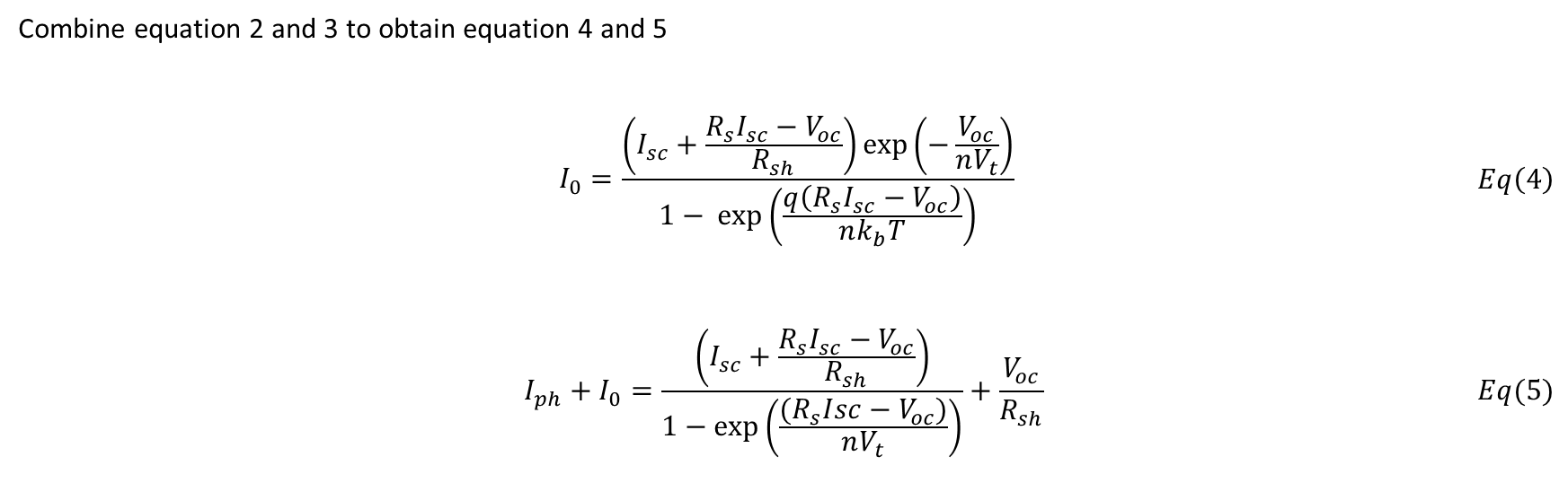
Combine equation 2 and 3 to obtain equation 4 and 5
$$\begin{aligned}\begin{aligned}I_{0}=\frac{\left(I_{sc}+\frac{R_{s}I_{sc}−V_{oc}}{R_{sh}}\right)\exp\left(−\frac{V_{oc}}{nV_{t}}\right)}{1− \exp\left(\frac{q\left(R_{s}I_{sc}−V_{oc}\right)}{nk_{b}T}\right)}\#\end{aligned}\#Eq\left(4\right)\end{aligned}$$
$$\begin{aligned}I_{ph}+I_{0}=\frac{\left(I_{sc}+\frac{R_{s}I_{sc}−V_{oc}}{R_{sh}}\right)}{1−\exp\left(\frac{{(R}_{s}Isc−V_{oc})}{nV_{t}}\right)}+\frac{V_{oc}}{R_{sh}}\#\#Eq(5)\end{aligned}$$
If the term $$\begin{aligned}\exp\left(\frac{q\left(R_{s}I_{sc}−V_{oc}\right)}{nk_{b}T}\right)≪1 \end{aligned}$$
Equation 5 can be reduced to
$$\begin{aligned}I_{ph}+I_{0}=I_{sc}+\frac{R_{s}I_{sc}}{R_{sh}}\#Eq(6)\end{aligned}$$

Slide 4
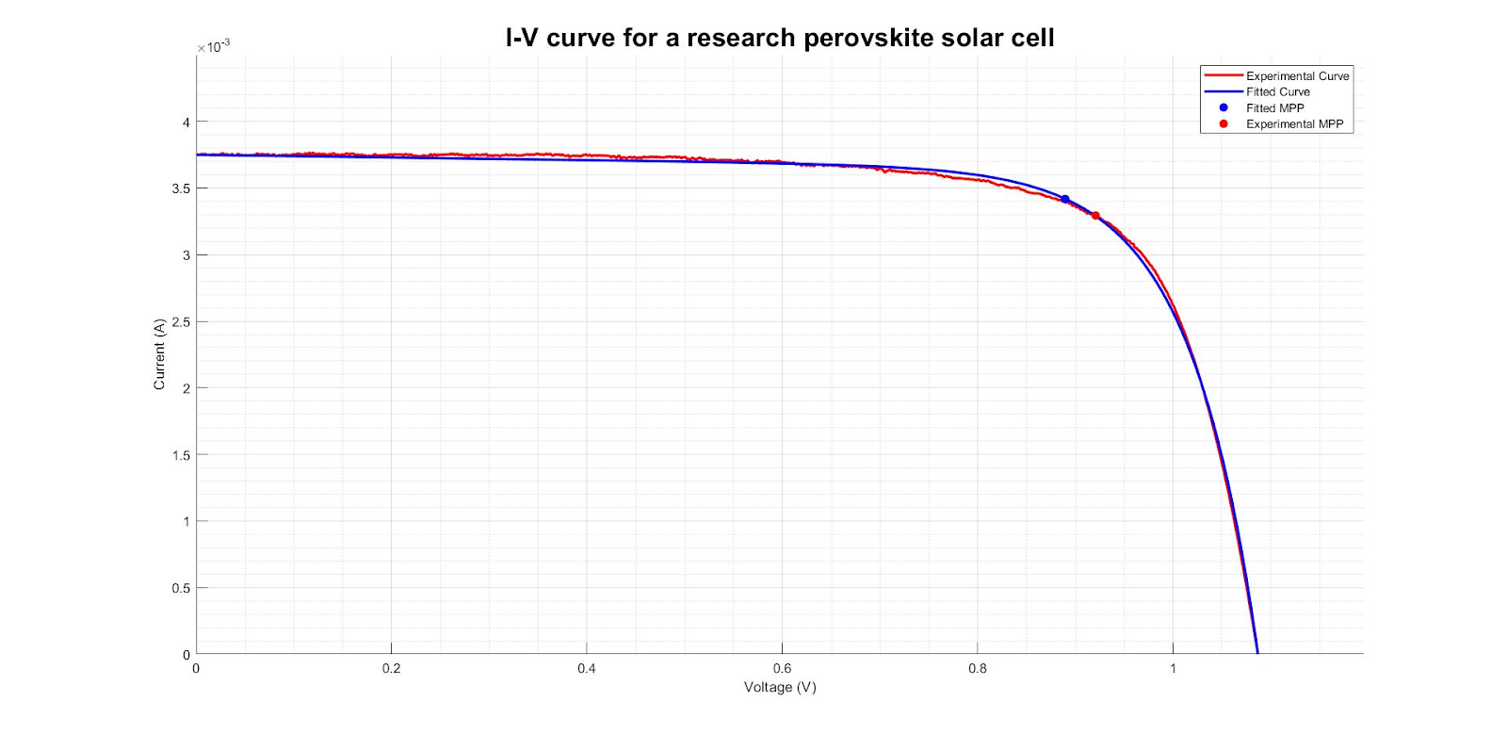
What is the problem?
Extracted Parameters
Rs (Ω) | Rsh (kΩ) | n
-1.28 | 10.00 | 2.88

Slide 5
Problem Statement
Current models for characterization are not reliable enough for high throughput characterization
Negative parameters
Initial guesses in literature are not applicable for all I-V data curves
Too far from the actual solution
Undefined at initial guess
Non realistic parameters extracted
Solutions to these problems mean
More accurate and reliable parameter extraction
Help understand the issue causing low fill factor

Slide 6
Hypothesis
Applying constraints to the possible $R_{s},R_{sh}$ and $n$ will improve the accuracy of the extracted parameters.

Slide 7
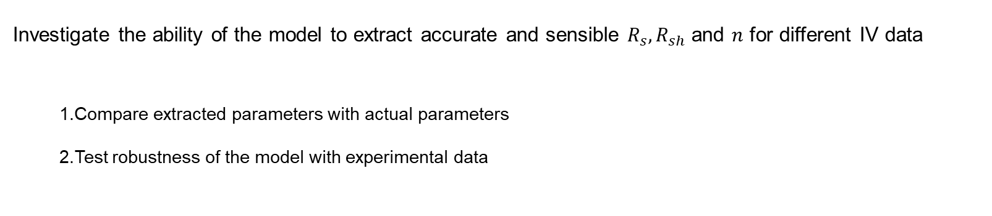
Objectives
Investigate the ability of the model to extract accurate and sensible $R_{s},R_{sh}$and $n$ for different IV data
Compare extracted parameters with actual parameters
Test robustness of the model with experimental data

Slide 8
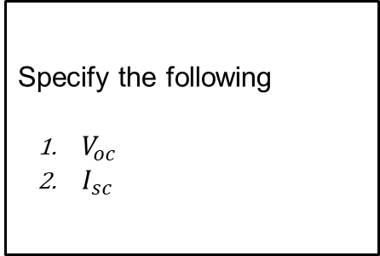
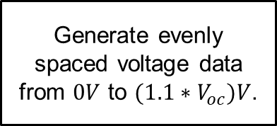
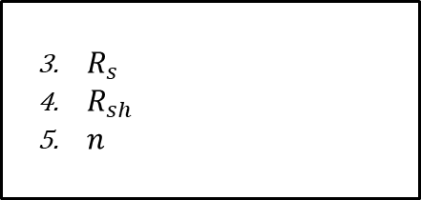
Simulate IV data
Specify the following
$V_{oc}$
$I_{sc}$
Introduce noise with signal to noise ratio (SR) of 45
Generate evenly spaced voltage data from $0V$ to $(1.1∗V_{oc})V$.
Generate current with explicit single diode equation.
$R_{s}$
$R_{sh}$
$n$

Slide 9
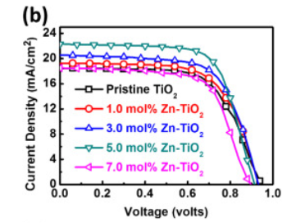
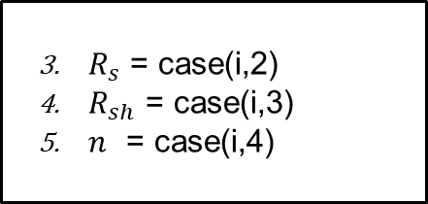
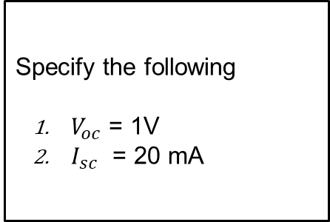
Simulated cases
Specify the following
$V_{oc}$ = 1V
$I_{sc}$ = 20 mA
Case | Rs (Ω) | Rsh (kΩ) | n
1 | 0.10 | 1.00E+03 | 1.00
2 | 25.00 | 1.00E+03 | 1.00
3 | 0.10 | 0.20 | 1.00
4 | 0.10 | 1.00E+03 | 2.50
5 | 25.00 | 1.00E+03 | 2.50
6 | 0.10 | 0.20 | 2.50
7 | 0.10 | 1.00E+03 | 5.00
8 | 25.00 | 0.20 | 5.00
$R_{s}$ = case(i,2)
$R_{sh}$ = case(i,3)
$n$ = case(i,4)

Slide 10
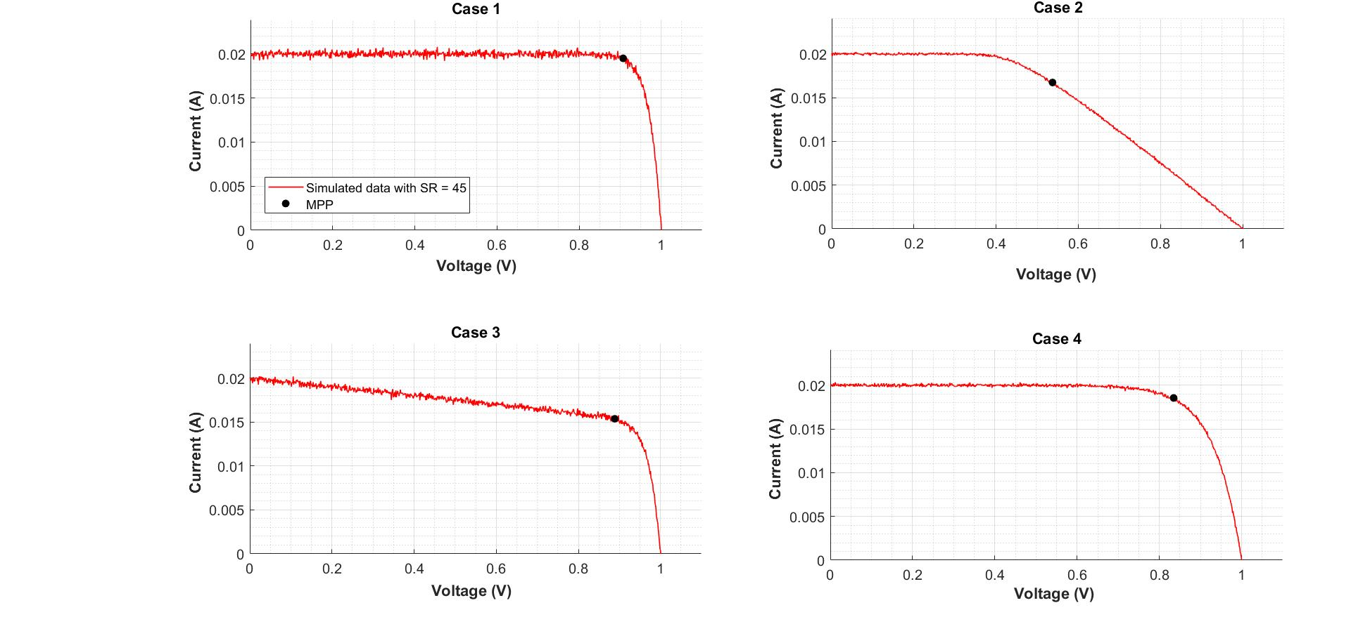
Simulated cases 1 - 4
Case | Rs (Ω) | Rsh (kΩ) | n
1 | 0.10 | 1.00E+03 | 1.00
2 | 25.00 | 1.00E+03 | 1.00
3 | 0.10 | 0.20 | 1.00
4 | 0.10 | 1.00E+03 | 2.50

Slide 11
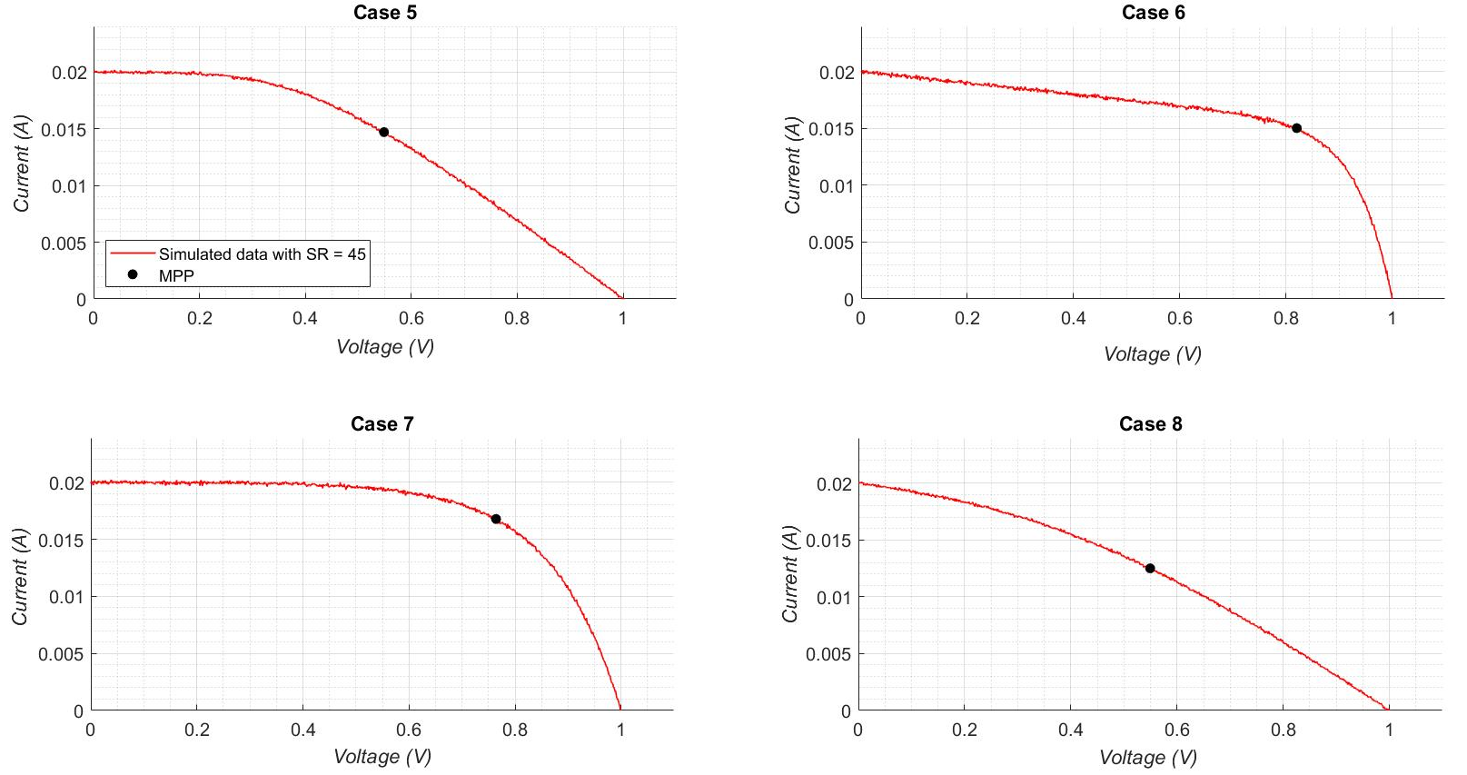
Simulated cases 5 - 8
Case | Rs (Ω) | Rsh (kΩ) | n
5 | 25.00 | 1.00E+03 | 2.50
6 | 0.10 | 0.20 | 2.50
7 | 0.10 | 1.00E+03 | 5.00
8 | 25.00 | 0.20 | 5.00

Slide 12
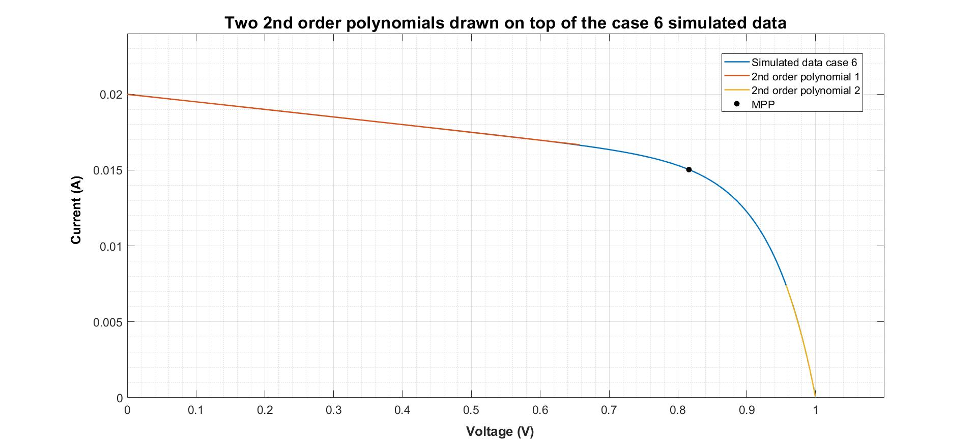


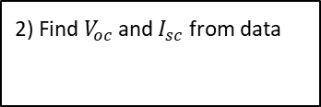
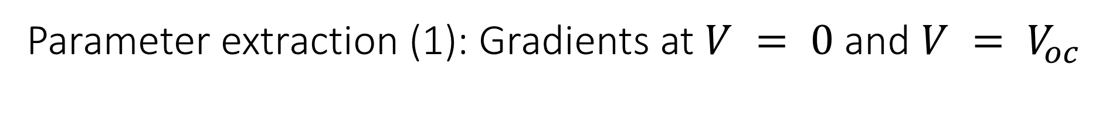
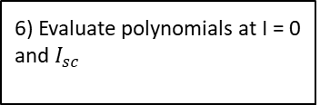

Parameter extraction (1): Gradients at $V = 0$and $V = V_{oc}$
1) Smooth current data
2) Find $V_{oc}$ and $I_{sc}$ from data
3) Find $V_{m}$ and $I_{m}$
4) Fit data with two 2nd order polynomials
5) Differentiate 2nd order polynomial
6) Evaluate polynomials at I = 0 and $I_{sc}$

Slide 13
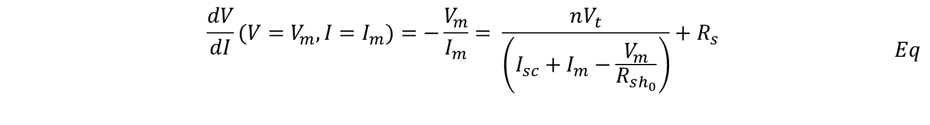
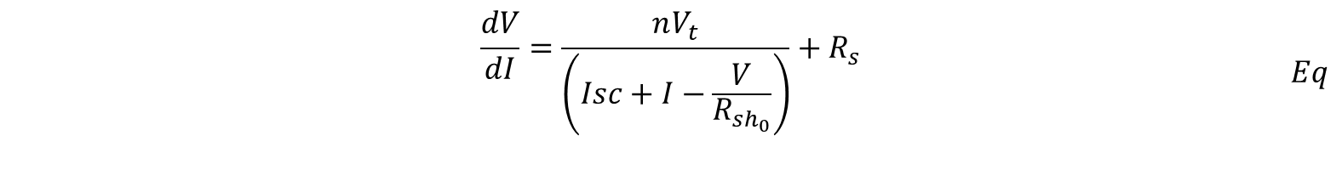
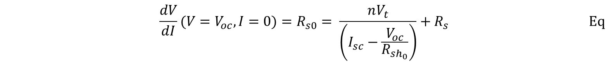
Parameter extraction (2) : Initial guesses
$$\begin{aligned}\begin{aligned}&\frac{dV}{dI}=\frac{nV_{t}}{\left(Isc+I−\frac{V}{R_{sh_{0}}}\right)}+R_{s}\#\#\end{aligned}\#Eq\end{aligned}$$
$$\begin{aligned}\begin{aligned}&\frac{dV}{dI}(V=V_{m}, I=I_{m})=−\frac{V_{m}}{I_{m}}= \frac{nV_{t}}{\left(I_{sc}+I_{m}−\frac{V_{m}}{R_{sh_{0}}}\right)}+R_{s }\#\end{aligned}\#Eq\end{aligned}$$
$$\begin{aligned}&\frac{dV}{dI}(V=V_{oc}, I=0)=R_{s0}= \frac{nV_{t}}{\left(I_{sc}−\frac{V_{oc}}{R_{sh_{0}}}\right)}+R_{s }\#\#Eq\end{aligned}$$

Slide 14
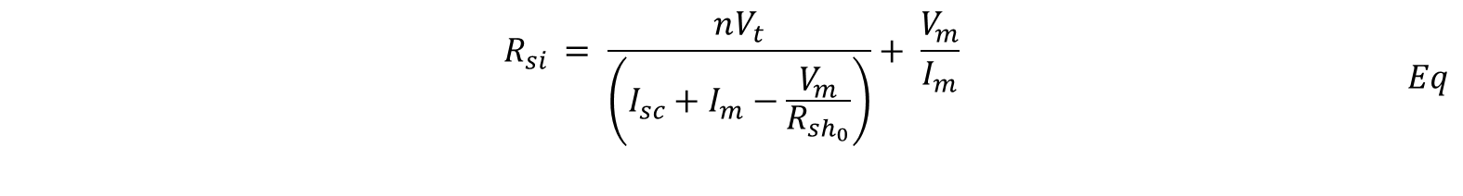
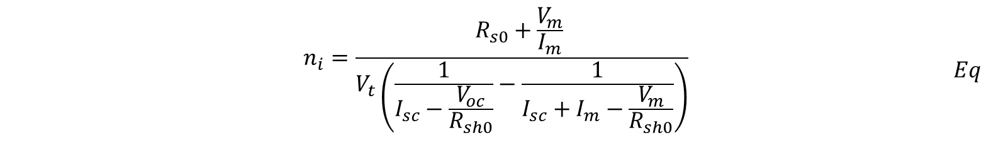
Equation 6 and 5 can be subtracted to obtain $n$ to as function of known parameters.
$$\begin{aligned}\begin{aligned}&n_{i}=\frac{R_{s0}+\frac{V_{m}}{I_{m}} }{V_{t}\left(\frac{1}{I_{sc}−\frac{V_{oc}}{R_{sh0}}}−\frac{1}{I_{sc}+I_{m}−\frac{V_{m}}{R_{sh0}}}\right)}\#\end{aligned}\#Eq\end{aligned}$$
$Rs$ can be retrieved by substituting the calculated in $n$ into equation (5). Equation (5) has been rearranged below to make $Rs$ as the subject of the formula.
$$\begin{aligned}\begin{aligned}&R_{si }= \frac{nV_{t}}{\left(I_{sc}+I_{m}−\frac{V_{m}}{R_{sh_{0}}}\right)}+ \frac{V_{m}}{I_{m}}\#\#\end{aligned}\#Eq\end{aligned}$$
$$\begin{aligned}&R_{shi }=R_{sh0}\#Eq\end{aligned}$$

Slide 15

Parameter extraction (3): Solver Setting
Use MATLAB built in ‘lsqnonlin’ function
Algorithm - trust region method
Tolerances = $1×{10}^{−10}$
Minimize least squares data in the active quadrant
Constraint the possible solutions of $R_{s},R_{sh}$and $n$

Slide 16
Analysis
Compare extracted parameters with actual parameters
Test robustness of the model on experimental data

Slide 17
Results
Simulated IV characterization
Literature IV characterization
Research solar cells characterization

Slide 18
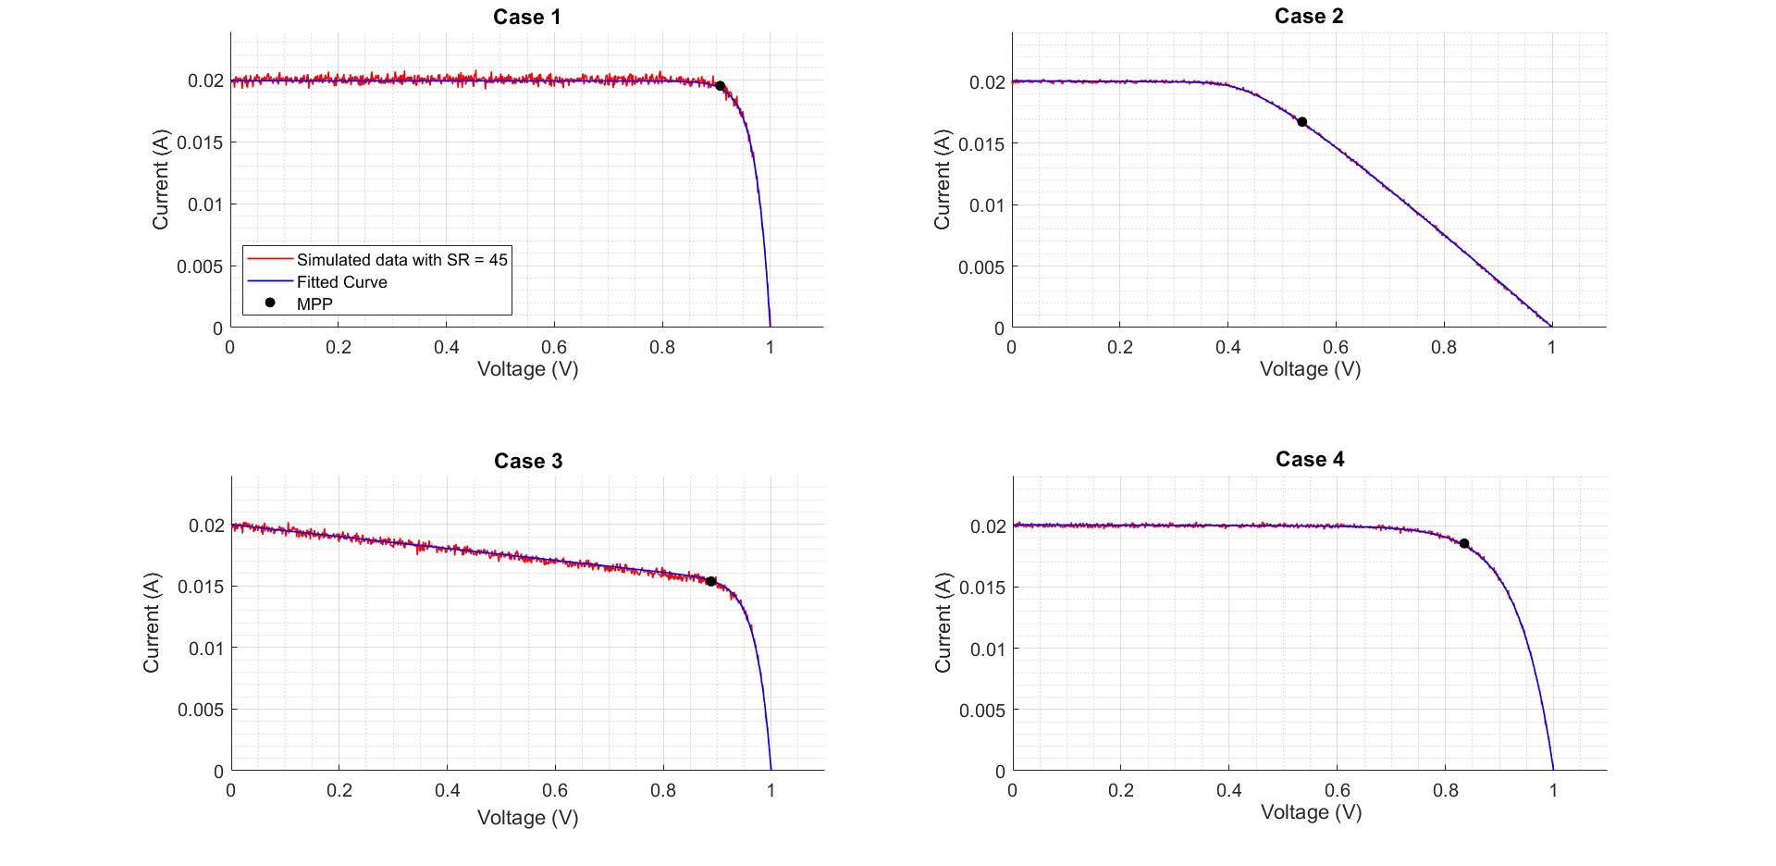
Simulated case 1 - 4

Slide 19
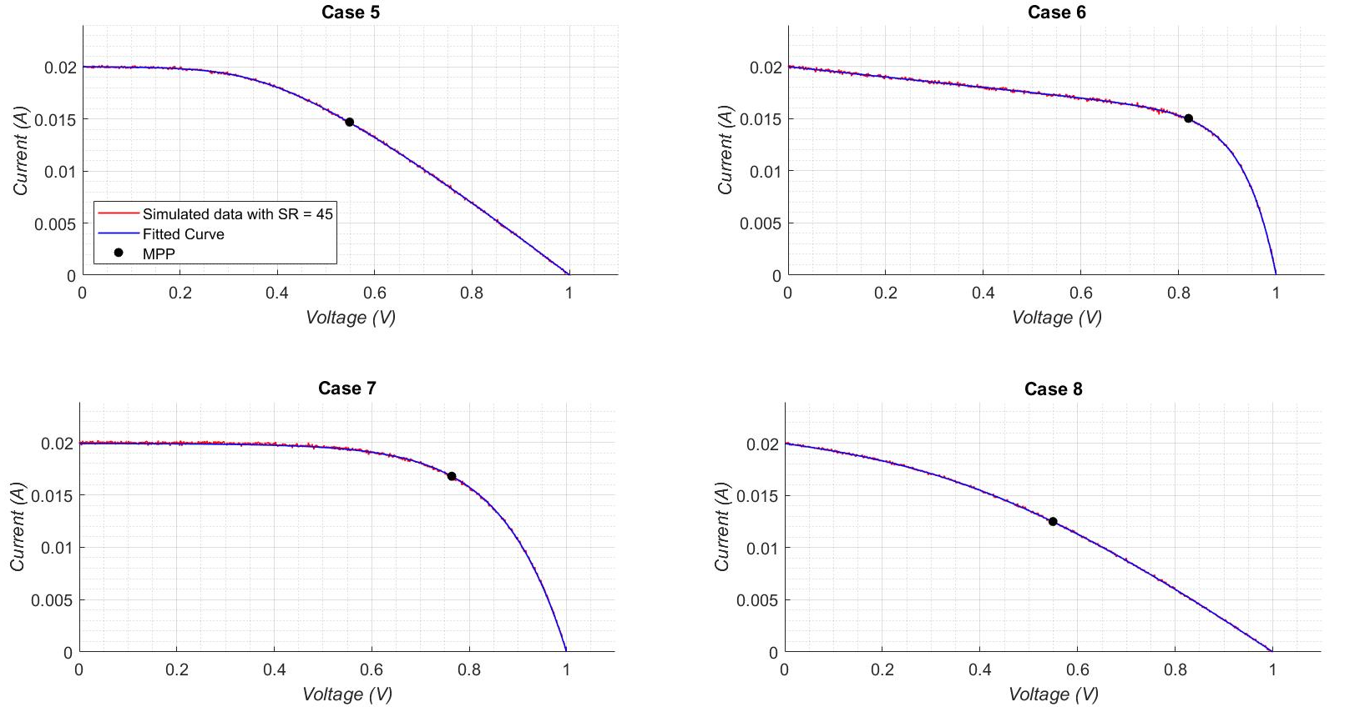
Simulated case 5 - 8

Slide 20
Simulated results
Case | Rs |  |  | Rsh |  |  | n |  |  | RMSE
 | Actual | Extract | %Error | Actual | Extract | %Error | Actual | Extract | %Error
1 | 0.10 | 0.07 | 33.08 | 1.00E+06 | 4.18E+04 | 95.82 | 1.00 | 1.00 | 0.00 | 1.32E-04
2 | 25.00 | 25.05 | 0.21 | 1.00E+06 | 4.22E+03 | 99.58 | 1.00 | 1.00 | 0.00 | 4.41E-05
3 | 0.10 | 0.00 | 99.90 | 2.00E+02 | 2.08E+02 | 3.85 | 1.00 | 1.06 | 5.53 | 1.12E-04
4 | 0.10 | 0.14 | 40.15 | 1.00E+06 | 6.63E+03 | 99.34 | 2.50 | 2.45 | 1.80 | 5.23E-05
5 | 25.00 | 25.22 | 0.86 | 1.00E+06 | 4.58E+03 | 99.54 | 2.50 | 2.42 | 3.09 | 3.20E-05
6 | 0.10 | 0.02 | 79.86 | 2.00E+02 | 2.02E+02 | 0.78 | 2.50 | 2.53 | 1.24 | 4.11E-05
7 | 0.10 | 0.53 | 426.42 | 1.00E+06 | 3.11E+04 | 96.89 | 5.00 | 4.72 | 5.55 | 7.62E-05
8 | 25.00 | 25.02 | 0.06 | 2.00E+02 | 2.09E+02 | 4.70 | 5.00 | 5.00 | 0.01 | 2.79E-05
Case 1 has highest RMSE in all cases
More noisy data
Large %error for high Rsh and low Rs
Low %error for n
RSME is not ultimate indicator of accuracy
Observe case 3 and 1

Slide 21
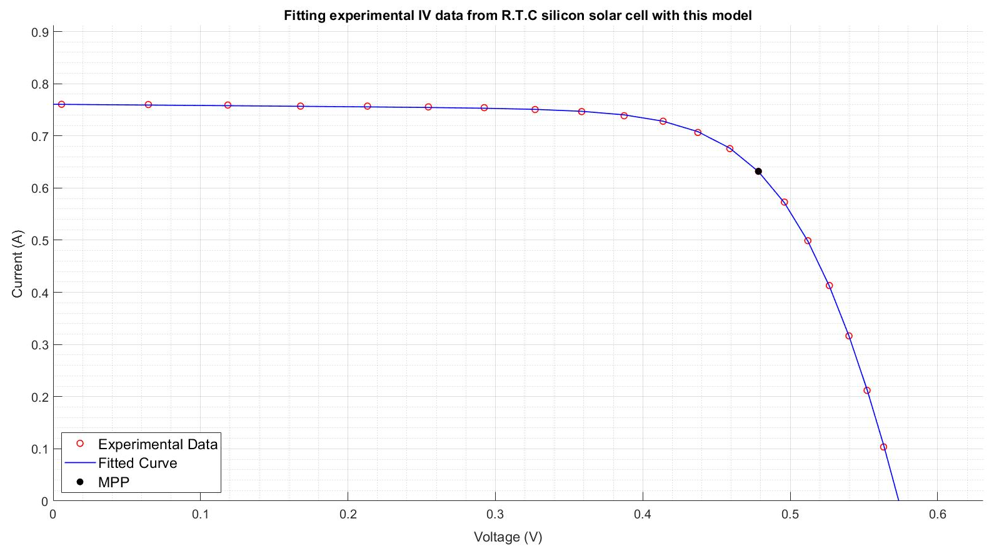
Fitting silicon solar cell IV data
Experimental data from a 57 mm diameter commercial (R.T.C France) silicon solar cell at 33 C.

Slide 22
Comparing Bee Swarm Method with this model
Rs |  |  | Rsh |  |  | n |  |  | RMSE
This method | Modified bee swarm | %Error | This method | Modified bee swarm | %Error | This method | Modified bee swarm | %Error | This method | Modified bee swarm | %difference
0.043 | 0.036 | 17.34 | 43.71 | 53.40 | 18.15 | 1.43 | 1.48 | 3.48 | 2.50E-03 | 9.86E-04 | 86.85

Slide 23
Fitting perovskite solar cells

